Slide 1
HawkIRB Research TEAM
IRB Training May 2014
Michele Myrvik
Program Specialist
Research & Development
Michele.Myrvik@va.gov
VA Ext 7645

Slide 2
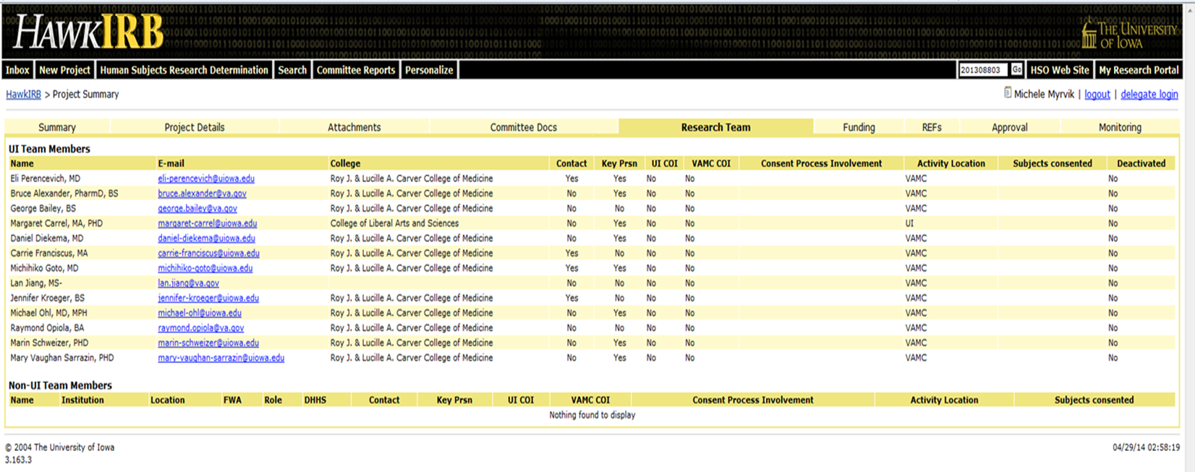
https://login.uiowa.edu/uip/login.page?service=https://hawkirb.research.uiowa.edu/hawkirb/
This TAB
Albert Einstein albert.einstein@whatever.com University of Zurich
Leopold Infeld Leopold .Infeld@whatever.com Jagiellonian University
Nathan Rosen Nathan.Rosen@whatever.com MIT
Peter Bergmann Peter.Bergmann@whatever.com German University

Slide 3
Before adding a new member to your IRB-03 Research Team, he/she is required to complete VA specific training and administrative documents if the VAMC is identified under activity location or subjects consented.
Tasks must be completed prior to obtaining physical access or logical (computer) access to the VA’s automated data processing equipment.
NO ONE should be permitted to work on the project until they have IRB committee approval.

Slide 4
Remember-if the activity location or subjects consented columns say VAMC the individual must be on some type of ‘Appointment’ at the VA.
Without Compensation (WOC) Appointment-for those who perform various research and training-related duties without any direct monetary compensation from the Department of Veterans Affairs. These types of appointments include but are not limited to fellows, residents, university employees, students or scientists who are not compensated by the VA for their employment.
Term/temporary Appointment- for those who are paid directly by the VA and are eligible to receive employment benefits.
Contract Appointment-for those who will be paid for their services through a contract.

Slide 5
ONBOARDING NEW TEAM MEMBERS
Task | Instructions | Notes:
1. Submit a copy of your resume or Application for Federal Employment (OF 612). | You can either provide a copy of your CV/Resume OR complete form OF-612 | Required to verify qualifications
2. Education Form |  | Required to verify credentials
3. OF-306 Declaration for Federal Employment |  | Required to complete background investigation
4. Fingerprint Form |  | Required to complete background investigation
5. Without Compensation Agreement |  | Valid for one year. Renewable.
6. Intellectual Property Agreement | For more information reference: VHA Handbook 1200.18
7. Assignment of Functional Categories | For more information reference: VHA Handbook 1605.02 | Valid for one year. Renewable.
8. Request for PIV Card |  | VA ID badge- required for physical access to the Research buildings & logical access to the computer systems.
9. Scope of Practice | Choose ONE applicable to your research project. a) Animal b) Biomedical c) Human Subjects | Valid one year. Renewable. If you have questions about the applicable routine duties, contact the Principal Investigator on the project.
10. Orientation Guide Acknowledgement | Review Orientation Guide
11. Complete online trainings titled: a) Privacy HIPAA and Focused b) VA Privacy and Information Security Awareness & Rules of Behavior | Set up your own profile by following these INSTRUCTIONS. | Log into: TMS Website Click “Create New User”
12. Complete online training titled: a) Human Subjects Protections and Good Clinical Practices (GCP) | ONLY REQUIRED IF YOUR PROJECT INVOLVES HUMAN SUBJECTS. Set up your own profile by following these INSTRUCTIONS. | Log into: CITI Website Click “Create an Account”
WHAT SHOULD I DO?
Notify the Research Office
The PI or Coordinator must enter a modification in HAWKIRB to add a new team member.
We will take care of the rest!! ☺
http://www.research.iowa-city.med.va.gov/Researchers/For_VA_Researchers.asp

Slide 6
REMOVING TEAM MEMBERS CLEARANCE PROCESS
Collect
Key Card (PIV)-terminate physical access to labs and other areas in the Research buildings.
HID card-terminate physical access other areas in the Research buildings.
Lab coats etc-Any other VA property.
Notify
VA Police to terminate physical access to labs and other areas in the Research buildings.
IT to terminate computer access
HR to terminate VA appointment
WHAT SHOULD I DO?
The PI or Coordinator must enter a modification in HawkIRB to remove a team member.
Notify the Research Office
We will take care of the rest!! ☺

Slide 7
Michele Myrvik
Program Specialist
Research & Development
Michele.Myrvik@va.gov
VA Ext 7645

