Slide 1
Common Errors to avoid in IRB-03 (VA) Applications

Slide 2
Overview of Today’s presentation
How do I know if I am using VA Resources?
What are the VA training requirements?
What do I do if I am storing PHI at my UI office?
Record retention policy
What is appropriate use of email?
Where is the HIPAA Authorization form located?

Slide 3
What is a “VA” Resource anyway?
VA Resources is a generally coined term which can encompass many things.
The most common VA Resources include:
Patients from the Iowa City VAHCS recruited as subjects
VA medical records either from the Iowa City VAHCS or other CPRS database
VA space
Where is your office located?
Where will you be storing the data?
VA funding
VA staff – If you have a research team member with a 8/8th appointment, the project must be reviewed under IRB-03.

Slide 4
VA Credentialing & Training requirements
VA training requirements are overseen by the VA Research Office.
All VA credentialing and training requirements as outlined in VHA 1200.05 (Paragraph 61-62) must be met prior to submitting a project to the IRB for review.
Projects submitted under IRB-03 listing research team members are vetted by the VA Liaison, Nadine Miller, to ensure these requirements are met.
VA training requirements must be complete at the time of submission or the research team member will need to be removed from Section II of the HawkIRB application in order to ensure continued processing.

Slide 5
Storing of subject data collected from a VA record source or from a Veteran
If there is any data collected from a subject enrolled at the Iowa City VAHCS and stored at a non VA Facility, the PI is required to:
Include this information in the informed consent document to inform the subject at the time of enrollment
List the location in Section X of the HawkIRB application
Include this information in the “Checklist for Reviewing Privacy, Confidentiality and Information Security in Research”
Include this information in the newly revised HIPAA Authorization Form

Slide 6
Data Retention Requirements
Current VA policy indicates no data collected for research purposes can be destroyed.
Research application should reflect all data collected as part of the study will be stored indefinitely.
If the project closes, data collected under the IRB-03 research study can be sent to the VA Research Office for storage.

Slide 7
Use of Email with VA subjects
Current VHA policy does not allow the use of email to recruit, enroll, or communicate with subjects enrolled under an IRB-03 study with one exception.
The only “approved” method of email communication is through the “MyHealtheVet” email until there is a revision to the existing VA recommendations.
Requests to contact subjects via other email methods will be returned to make updates to adhere to this policy.
RECENT Change: The irb@uiowa.edu email address is being removed from the “What If I Have Question” section of the consent document to adhere to this policy.

Slide 8
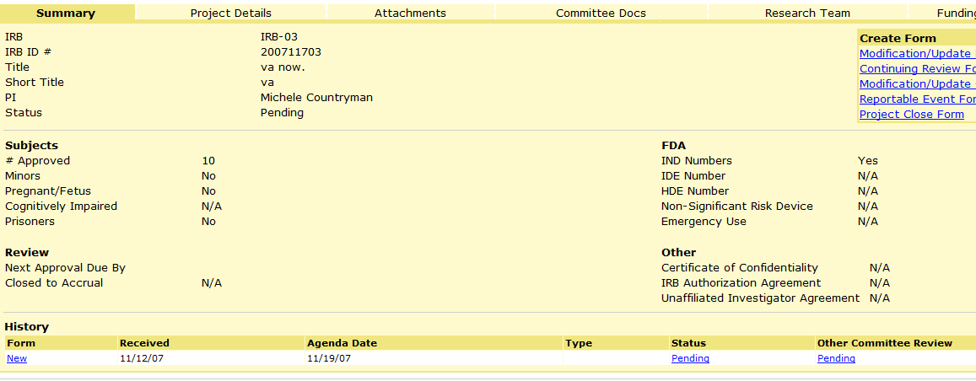
VA HIPAA Authorization
If you are accessing and creating PHI, the VA HIPAA Authorization must be completed to reflect what information is being collected.
This form is signed by the subject when the informed consent document is signed.
One of the most common compliance finding in the recent year.
The VA (HIPAA) forms and checklists are located under the “Other Committee Review” link from the Project Summary page as seen indicated by the arrow above.

Slide 9
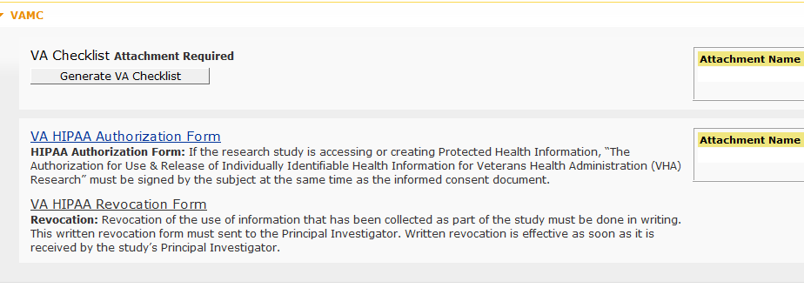
The “Other Committee Review” tab is the where the VA HIPAA Authorization and Revocation form can be downloaded, completed, and added to the HawkIRB application.
Below is the final location of the HIPAA forms

Slide 10
Questions?
Contact:
Michele Countryman, CIP
Assistant Director
Michele-countryman@uiowa.edu
(319)353-4452
OR irb@uiowa.edu (319)335-6564

